Slide 1
Chapter 2
The Pandas essentials for data analysis

Slide 2
Objectives (part 1)
Applied
Create a DataFrame by reading data from a file or by using the DataFrame constructor.
Save a DataFrame to disk as a pickle file, and restore the DataFrame by reading the pickle file.
Examine the data in a DataFrame by displaying the data and its attributes.
Examine the data in a DataFrame by using the info(), nunique(), and describe() methods.
Access columns, rows, or a subset of columns and rows by using some combination of dot notation, brackets, the query() method, and the loc[] or iloc[] accessor.
Use Pandas methods to get statistics for the columns of a DataFrame.

Slide 3
Objectives (part 2)
Use Python to do calculations on the data in the columns of a DataFrame.
Use the Pandas or Python replace() method to replace the data in a DataFrame or Series object.
Use Pandas methods to do the following DataFrame operations:
Sort the rows
Set and reset an index
Pivot the data
Melt the data
Group and aggregate the data
Plot the data based on the index that has been set

Slide 4
Objectives (part 3)
Knowledge
Distinguish between a Series and a DataFrame.
Describe these attributes of a DataFrame: values, index, columns, shape.

Slide 5
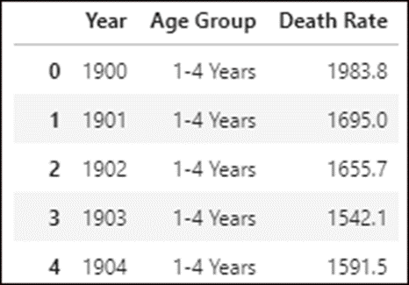
The first five rows of the Child Mortality data in a DataFrame

Slide 6
The components of a DataFrame
Component | Description
Column labels | The names at the tops of the columns.
Column data | The data in the columns. All of the data in a column typically has the same data type with one entry in each row.
Column data types | Each column has a defined data type. If all of the elements in a column don’t have the same data type, the elements are stored with the object data type.
Index | Also known as a row label. If an index isn’t defined, it is generated as a sequence of integers starting with zero.
Metadata | Attributes of the DataFrame that are generated by Pandas when the DataFrame is constructed or changed.

Slide 7
Terms related to DataFrame objects
DataFrame
Column
Row
Series object
Element
Datapoint

Slide 8
Three of the Pandas read() methods for importing data into a DataFrame
read_csv()
read_excel()
read_sql_query()
How to import a CSV file from a website
import pandas as pd
url = "https://data.cdc.gov/api/views/v6ab-adf5/" + "rows.csv?accessType=DOWNLOAD"
mortality_data = pd.read_csv(url)

Slide 9
The DataFrame() constructor
DataFrame(params)
Parameters
data
columns
index

Slide 10
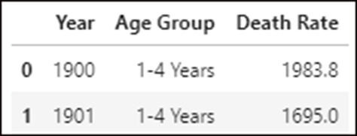
The data and columns arrays for a DataFrame
df_data=[[1900, '1-4 Years', 1983.8],[1901, '1-4 Years', 1695.0]]
df_columns=['Year', 'Age Group', 'Death Rate']
The code that creates the DataFrame
import pandas as pd
mortality_df = pd.DataFrame(
data=df_data,
columns=df_columns)
The DataFrame that’s created

Slide 11
Three of the Pandas methods for saving a DataFrame to disk
to_pickle()
to_csv()
to_excel()
How to save a DataFrame as a pickle file
mortality_data.to_pickle('mortality_data.pkl')

Slide 12
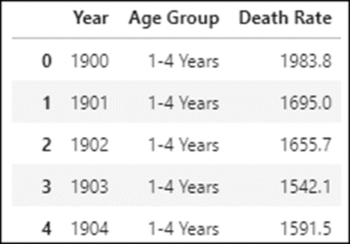
The Pandas read_pickle() method
read_pickle(filename)
How to read a pickle file to restore a DataFrame
mortality_data = pd.read_pickle('mortality_data.pkl')
The DataFrame that’s restored

Slide 13
Two methods for displaying the data in a DataFrame
head(rows)
tail(rows)

Slide 14
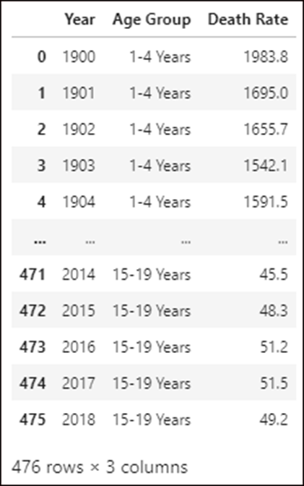
JupyterLab automatically displays the contents of a named DataFrame
mortality_data

Slide 15
How to use the head() and tail() methods
mortality_data.head() # displays the first 5 rows
mortality_data.tail(3) # displays the last 3 rows
How to display the data in 5 rows and all columns
with pd.option_context(
'display.max_rows', 5,
'display.max_columns', None):
display(mortality_data)

Slide 16
Some of the attributes of a DataFrame object
Attribute | Description
values | The values of the DataFrame in an array format
index | The row index
columns | The column names
size | The total number of elements
shape | The number of rows and columns

Slide 17
The values attribute
mortality_data.values
=================================================
array([[1900, '1-4 Years', 1983.8],
[1901, '1-4 Years', 1695.0],
[1902, '1-4 Years', 1655.7],
...,
[2016, '15-19 Years', 51.2],
[2017, '15-19 Years', 51.5],
[2018, '15-19 Years', 49.2]], dtype=object)

Slide 18
The other four attributes
print("Index: ", mortality_data.index)
print("Columns:", mortality_data.columns)
print("Size: ", mortality_data.size)
print("Shape: ", mortality_data.shape)
==================================================================
Index: RangeIndex(start=0, stop=476, step=1)
Columns: Index(['Year', 'Age Group', 'Death Rate'], dtype='object')
Size: 1428
Shape: (476, 3)

Slide 19
How to use the columns attribute to replace spaces with nothing
mortality_data.columns = mortality_data.columns.str.replace(' ', '')
The new column names
Index(['Year', 'AgeGroup', 'DeathRate'], dtype='object')

Slide 20
The info(), nunique(), and describe() methods
Method | Description
info(params) | Returns information about the DataFrame and its columns.
nunique() | Returns the number of unique data items in each column.
describe() | Returns statistical information for each numeric column.

Slide 21
How to use the info() method
mortality_data.info()
=====================================
<class 'pandas.core.frame.DataFrame'>
RangeIndex: 476 entries, 0 to 475
Data columns (total 3 columns):
Year 476 non-null int64
AgeGroup 476 non-null object
DeathRate 476 non-null float64
dtypes: float64(1), int64(1), object(1)
memory usage: 11.3+ KB
The memory_usage parameter ensures a more accurate usage result
mortality_data.info(memory_usage='deep')
========================================
<class 'pandas.core.frame.DataFrame'>
...
memory usage: 38.7 KB

Slide 22
How to use the nunique() method
mortality_data.nunique()
========================
Year 119
AgeGroup 4
DeathRate 430
dtype: int64

Slide 23
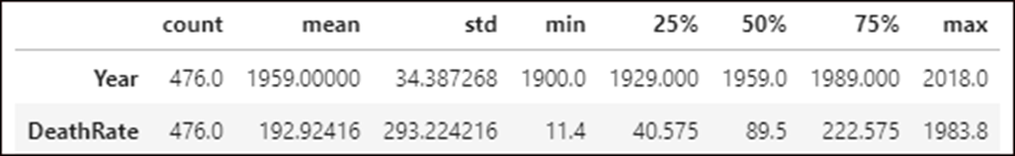
How to use the describe() method
With the T property, the statistics are displayed in the columns
mortality_data.describe().T
Without the T property, the statistics are displayed in the rows
mortality_data.describe()

Slide 24
The syntax for accessing columns
To access | With brackets | With dot notation
One column | df[column_name] df[[column_name]] | df.column_name
Two or more columns | df[[col1,col2,...]]

Slide 25
Two ways to access one column
With dot notation
mortality_data.DeathRate.head(2)
================================
0 1983.8
1 1695.0
Name: DeathRate, dtype: float64
With brackets
mortality_data['DeathRate'].head(2)
===================================
0 1983.8
1 1695.0
Name: DeathRate, dtype: float64

Slide 26
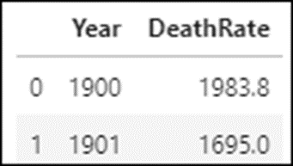
How to use a list to access two or more columns
mortality_data[['Year','DeathRate']].head(2)

Slide 27
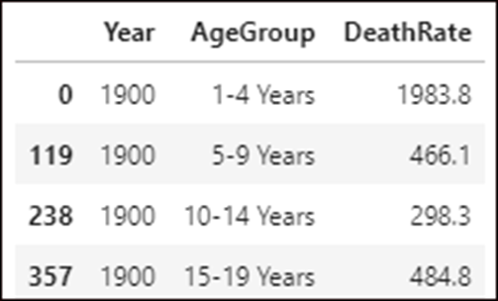
The query() method
query(condition)
How to use the query() method to access rows (part 1)
Based on a single column
mortality_data.query('Year == 1900')

Slide 28
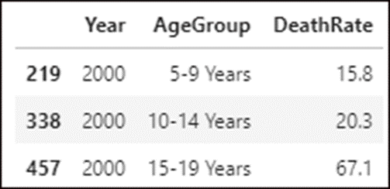
How to use the query() method to access rows (part 2)
Based on multiple columns with the and operator
mortality_data.query('Year == 2000 and AgeGroup != "1-4 Years"')

Slide 29
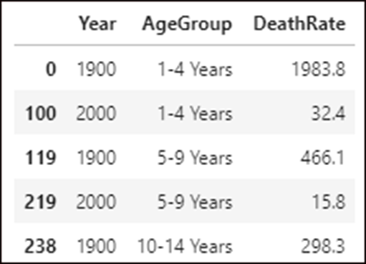
How to use the query() method to access rows (part 3)
Based on multiple columns with the or operator
mortality_data.query('Year == 1900 or Year == 2000').head()
With backticks for column names that contain spaces
mortality_data.query('Year == 2000 and `Age Group` != "1-4 Years"')

Slide 30
How to access one column from a subset of rows using dot notation
mortality_data.query('Year == 1900').DeathRate
==============================================
0 1983.8
119 466.1
238 298.3
357 484.8
Name: DeathRate, dtype: float64
How to access one column from a subset of rows using brackets
mortality_data.query('Year == 1900')['DeathRate']
=================================================
0 1983.8
119 466.1
238 298.3
357 484.8
Name: DeathRate, dtype: float64

Slide 31
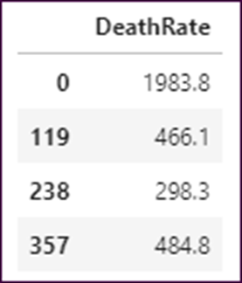
How to access one column from a subset of rows using a list
mortality_data.query('Year == 1900')[['DeathRate']]

Slide 32
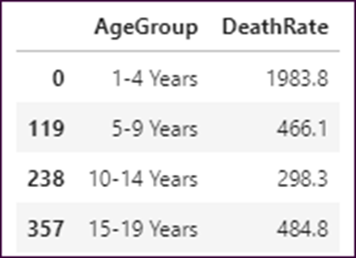
How to access two or more columns from a subset of rows using a list
mortality_data.query('Year == 1900')[['AgeGroup','DeathRate']]

Slide 33
The loc[ ] and iloc[ ] accessors for accessing rows and columns
Accessor | Accesses rows and columns
loc[rows,columns] | by their labels.
iloc[rows,columns] | by their positions.

Slide 34
How to access rows with the loc[ ] accessor
With a list to access the rows with labels 0, 5, and 10
mortality_data.loc[[0,5,10]]
With a slice to access the rows with labels 4 through 6
mortality_data.loc[4:6]
With a slice to access every 5th row from 0 through 20
mortality_data.loc[0:20:5]
With a conditional expression to access the rows for the year 1917
mortality_data.loc[mortality_data.Year == 1917]

Slide 35
How to access rows and columns with the loc[ ] accessor
With lists of row and column labels
mortality_data.loc[[0,5,10],['AgeGroup','DeathRate']]
With slices of row and column labels
mortality_data.loc[4:6,'AgeGroup':'DeathRate']

Slide 36
How to access rows and columns with the iloc[ ] accessor
With lists of row and column positions
mortality_data.iloc[[4,5,6],[1,2]]
With slices of row and column positions
mortality_data.iloc[4:7,1:3]
With a negative row position in a slice to access the last 10 rows
mortality_data.iloc[-10:]

Slide 37
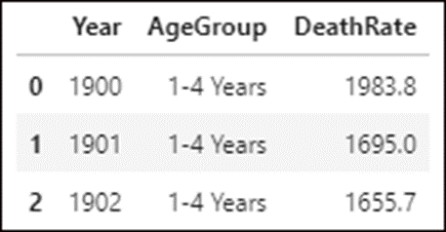
The sort_values() method
sort_values(columns, ascending)
How to sort by one column in descending order
mortality_data.sort_values('DeathRate', ascending=False).head(3)

Slide 38
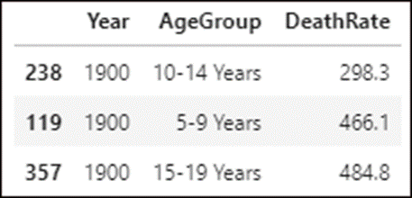
How to sort by multiple columns in ascending order
mortality_data.sort_values(['Year','DeathRate']).head(3)

Slide 39
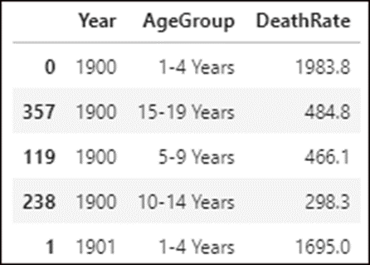
How to sort by multiple columns in mixed orders
mortality_data.sort_values(['Year','DeathRate'],
ascending=[True,False]).head()

Slide 40
Some of the Pandas methods for both Series and DataFrame objects
count()
mean()
median()
min()
max()
std()
sum()
cumsum()
quantile(q)

Slide 41
How to apply a method to one column
mortality_data.DeathRate.mean()
===============================
192.92415966386568
How to apply a method to two columns
mortality_data[['AgeGroup','DeathRate']].max()
==============================================
AgeGroup 5-9 Years
DeathRate 1983.8
dtype: object
How to apply a method to all columns
mortality_data.count()
======================
Year 476
AgeGroup 476
DeathRate 476
dtype: int64

Slide 42
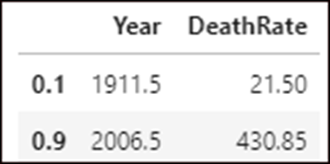
How to apply the quantile() method to two different quantiles
mortality_data.quantile([.1,.9])

Slide 43
The Python operators for column arithmetic
Operator | Name
+ | Addition
- | Subtraction
* | Multiplication
/ | Division
// | Integer division
% | Modulo/Remainder
** | Exponentiation

Slide 44
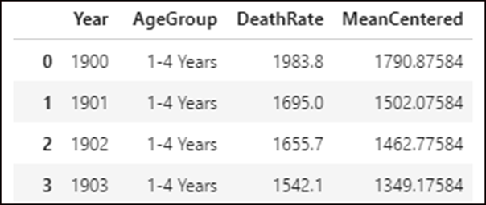
How to add a column to a DataFrame
mortality_data['MeanCentered'] = \
mortality_data.DeathRate - mortality_data.DeathRate.mean()

Slide 45
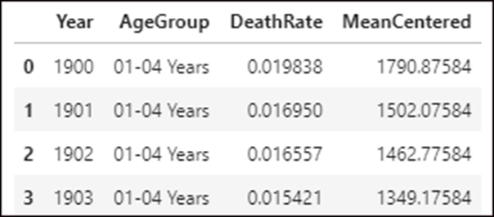
How to modify the data in an existing column
mortality_data['DeathRate'] = \
mortality_data.DeathRate / 100000

Slide 46
The Pandas replace() method
replace(to_replace,value, inplace)
The Python replace() method
replace(old,new)

Slide 47
How to modify the string data in a column
With the Pandas replace() method with three parameters
mortality_data.AgeGroup.replace(
to_replace = ['1-4 Years','5-9 Years'],
value = ['01-04 Years','05-09 Years'],
inplace = True)
With the Pandas replace() method and a dictionary of old and new values
mortality_data.AgeGroup.replace(
{'1-4 Years':'01-04 Years','5-9 Years':'05-09 Years'},
inplace = True)
With the Python replace() method
mortality_data['AgeGroup'] =
mortality_data.AgeGroup.str.replace('1-4 Years', '01-04 Years')
mortality_data['AgeGroup'] =
mortality_data.AgeGroup.str.replace('5-9 Years', '05-09 Years')

Slide 48
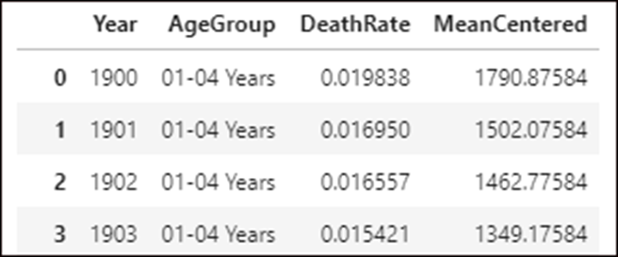
The result for all three of the examples

Slide 49
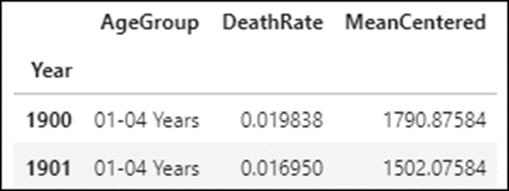
The set_index() method
set_index(columns, verify_integrity)
How to set a one-column index
mortality_data = mortality_data.set_index('Year')
mortality_data.head(2)

Slide 50
How to verify the integrity of a one-column index
mortality_data = mortality_data.set_index('Year', verify_integrity=True)
mortality_data.head(2)
==========================================================================
ValueError: Index has duplicate keys: Int64Index([1900, 1901, ....

Slide 51
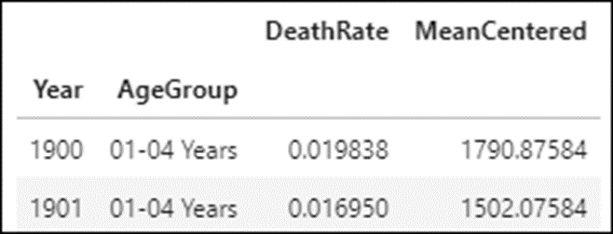
How to set a two-column index
mortality_data.set_index(['Year','AgeGroup'], verify_integrity=True)
mortality_data.head(2)

Slide 52
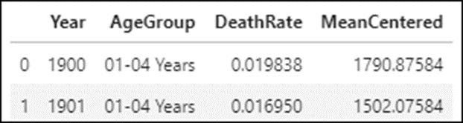
The reset_index() method
reset_index(inplace)
How to reset an index
mortality_data.reset_index(inplace=True)
mortality_data.head(2)

Slide 53
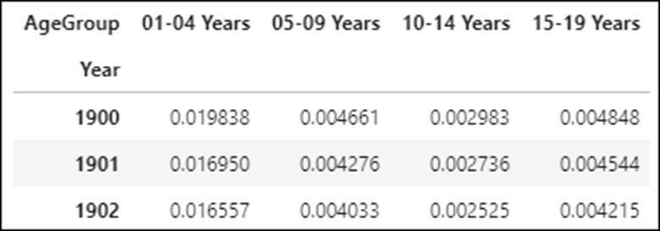
The pivot() method of a DataFrame
pivot(index,columns,values)
How to pivot the AgeGroup column for the death rate
mortality_wide = mortality_data.pivot(
index='Year', columns='AgeGroup', values='DeathRate')
mortality_wide.head(3)

Slide 54
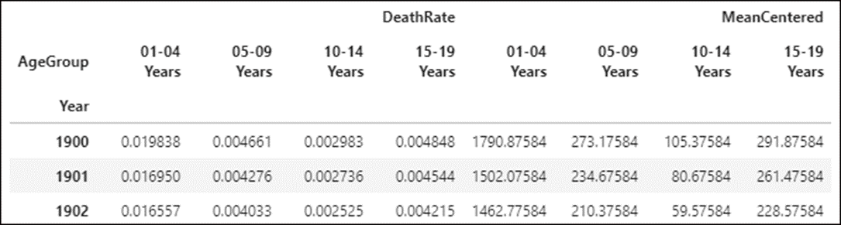
How to pivot the AgeGroup column for all other data
mortality_wide = mortality_data.pivot(
index='Year', columns='AgeGroup')
mortality_wide.head(3)

Slide 55
The melt() method of a DataFrame
Method | Description
melt(params) | Melts the data in two or more columns into a single column.
Parameters of the melt() method
Parameters | Description
id_vars | The column or columns that identify each row.
value_vars | The columns to melt. If none are specified, all other columns will be melted.
var_name | The name of the column that will contain the melted column names, or “variable” by default.
value_name | The name of the column that will contain the values, or “value” by default.

Slide 56
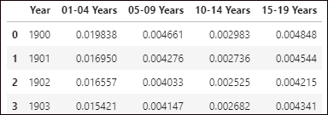
The starting DataFrame in wide form

Slide 57
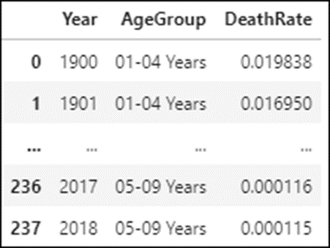
How to melt the data for just the 01-04 and 05-09 columns
mortality_long = mortality_wide.melt(
id_vars = 'Year',
value_vars=['01-04 Years','05-09 Years'],
var_name ='AgeGroup',
value_name='DeathRate')

Slide 58
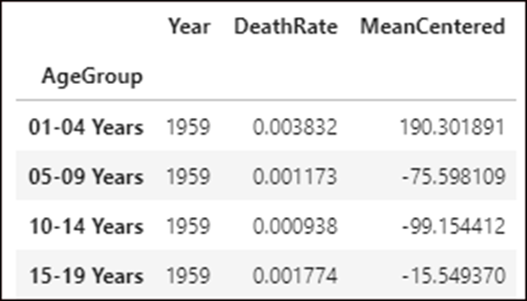
The groupby() method
groupby(columns)
How to group the data on the AgeGroup column
mortality_data.groupby('AgeGroup').mean().head(4)

Slide 59
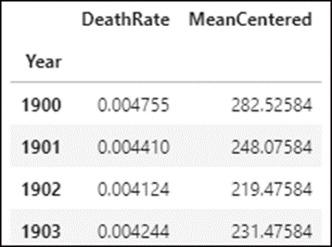
How to group the data on the Year column
mortality_data.groupby('Year').median().head(4)

Slide 60
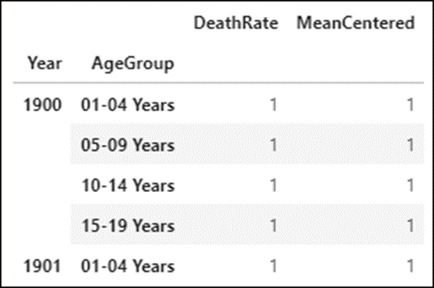
How to group the data on multiple columns
mortality_data.groupby(['Year','AgeGroup']).count().head()

Slide 61
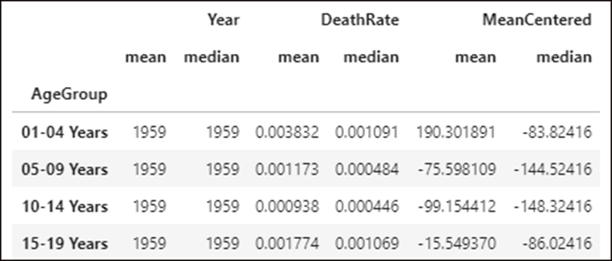
The agg() method
agg(methods)
How to aggregate the data for all columns in each age group
mortality_data.groupby('AgeGroup').agg(['mean','median'])

Slide 62
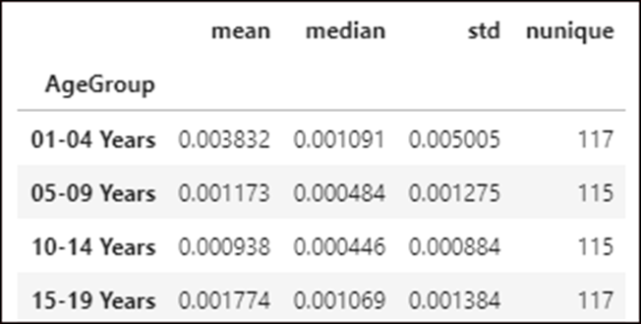
How to aggregate the data for just the death rate in each age group
mortality_data.groupby('AgeGroup')['DeathRate'] \
.agg(['mean','median','std','nunique'])

Slide 63
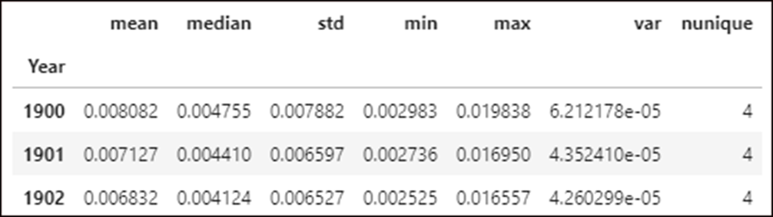
How to aggregate the data for just the death rate in each year group
mortality_data.groupby('Year')['DeathRate'] \
.agg(['mean','median','std','min','max','var','nunique'])

Slide 64
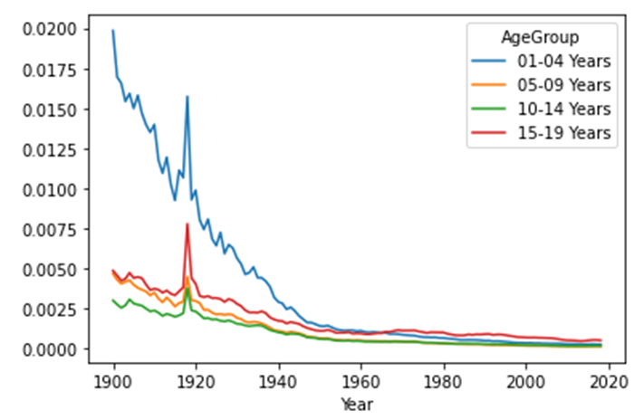
How to chain the pivot() and plot() methods
mortality_data.pivot(index='Year', columns='AgeGroup')['DeathRate'].plot()

Slide 65
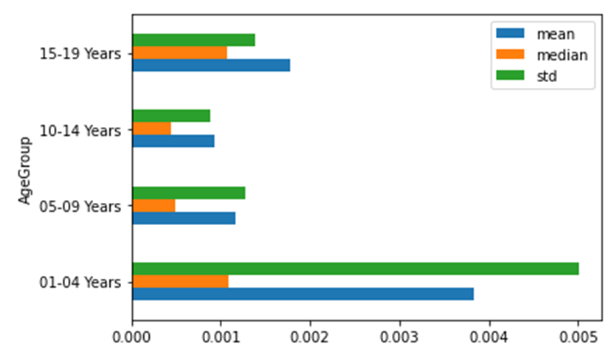
How to chain the groupby(), agg(), and plot() methods
mortality_data.groupby('AgeGroup')['DeathRate'] \
.agg(['mean','median','std']).plot.barh()

